Slide 1
Walmart Stores dataset

Slide 2
Hello!
I am Sarah ALhaidari
You can find me at GitHub:
@sarahalhaidari

Slide 3
Overview
Introduction
Data Cleaning
Questions and Results
Tools
Modeling
Conclusion

Slide 4

INTRODUCTION
One of the largest retail supermarkets in the United States, I would like to predict the sales . There are certain events and holidays which impact sales on each day

Slide 5
Data Cleaning
Change the inconsistent text in data column
Insert a columns called ‘day’ , ‘month’ and ‘year’
Insert a columns called ‘ Labour Day، Thanksgiving، Christmas، Super Bowl
Insert a column called ‘seasons’

Slide 6
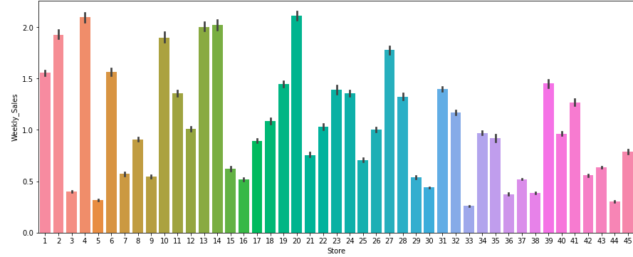
Questions and Results
What store has the most sales?

Slide 7
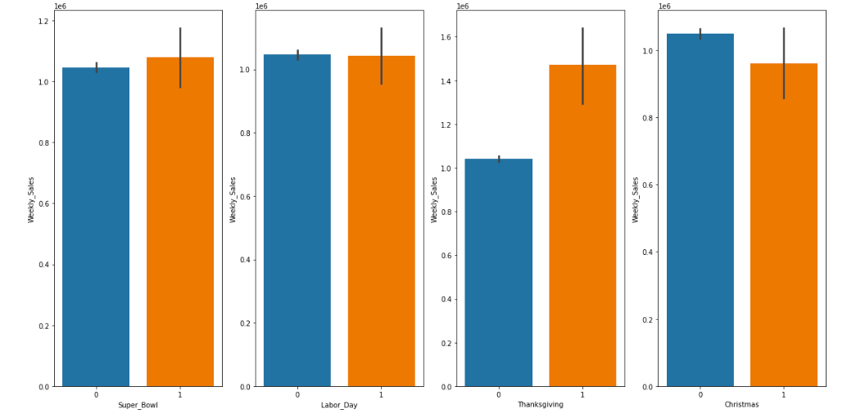
Questions and Results
What holidays have the most sales?what are the least?

Slide 8
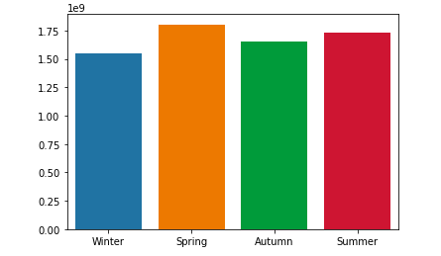
Questions and Results
What seasons have the most sales?what are the least?

Slide 9
The higher the percentage of sales, the lower the unemployment rate.

Slide 10







Tools
Jupyter
Numpy
Datetime Scikit-learn
Pandas
Seaborn
Matplotlib

Slide 11

Machine Learning Model
Linear Regression Model
Decision Tree Model
Random Forest Model

Slide 12
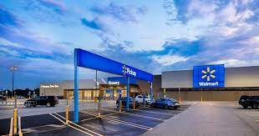
Conclusion
In summary, the beneficiaries of this project are the supermarket owners and the general public
We knew which holidays have the most sales and the most seasons

Slide 13
Thanks!
Any questions?
You can find me at GitHub @sarahalhaidari

